Slide 1
Time and Motion
Python with Robots Mission 3
Lesson 1 Objectives 1-5

Slide 2

Pre-Mission Warm-Up
In your Mission 3 Lesson 1 log, answer the pre-mission warm-up questions:
What is the code for turning on a user LED?
What is the code for turning off a user LED?

Slide 3
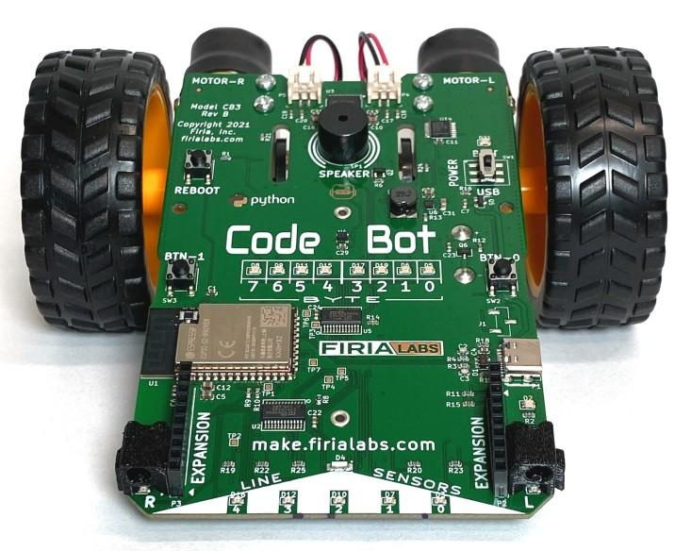
Mission 3: Time and Motion
When you write code for CodeBot, you are doing physical computing. From cars to lights, code is at the heart of many things!
You will use Python’s time library to precisely control the timing of your ‘bot’s lights and actions.

Slide 4
Mission 3: Project Goals
Flash CodeBot’s LEDs in a controlled sequence.
Make a light show using all the LEDs.
Learn how to use the CodeSpace debugger.
Power up the motors to move and rotate your ‘bot.
Write code to drive in a specified pattern.
Use pushbutton inputs to control the action.

Slide 5
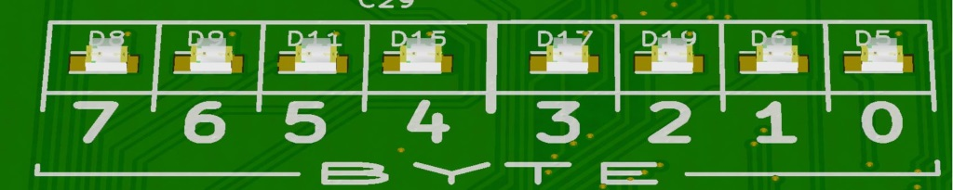
Objective #1: LED Sequencer
You already know how to turn the user LEDs on and off.
Now it is time for some fancy lights!
Can you make the user lights turn ON in an animated sequence?
You want to write code that will turn on four LEDs one at a time, in order.

Slide 6
Objective #1 Activity
DO THIS:
Start a new file – SequenceLEDs
Follow CodeTrek to write the code that turns on four user LEDs in sequence.
What do you observe? Answer the question in the Mission 3 Log.

Slide 7
Objective #2: The Debugger
Inside the mind of the computer!
Computers are fast!
The CodeSpace debugger lets you step through your program one line at a time, at your own speed, so you can see what the computer is doing.
NOTE: The highlighted line of code runs after the Step button is clicked.

Slide 8
Objective #2 Activity
DO THIS:
Follow the steps to run the debugger
Click “Debug Program”.
Click “Step in”.
Click “Step in” again, several times.
The highlighted line executes after “Step in” is clicked.
Watch what happens on CodeBot each time you click “Step in”.
Record your observations.

Slide 9
Objective #3: Slow It Down
When you step through the code, you see the LEDs light in sequence.
You just need a way to delay the computer a little bit after it lights each LED.
You can use the sleep() function from the time library.
First import the function:
from time import sleep
You import only one time, at the top of your program.

Slide 10

Objective #3: Slow It Down
Use the sleep() function in the time library.
The sleep() function will pause CodeBot instructions.
The number you put inside the parentheses is called an argument.
The value of an argument is passed to the function in the function call.
The argument tells the computer how long to pause.
The sleep(1.0) command will pause the code for 1 second.
Use a sleep(1.0) command after turning on each user LED:
leds.user_num(0, True)
sleep(1.0)

Slide 11
Objective #3 Activity
DO THIS:
Follow CodeTrek to:
Import sleep from the time library
Add the sleep() function after turning on each user LED.
Run your code.
Answer the question in your mission log.

Slide 12
Objective #4: Variable Speed
Can you change the speed of the LEDs as they light up?
To change the delay, you need to change the 1.0 in sleep().
The 1.0 appears three times, so you would have to change it three times.
Wouldn’t it be nice to set the delay in one place?
Instead of using a number, like 1, you can use a name instead.

Slide 13
Objective #4: Variable Speed
The value 1.0 is a literal number.
It is a specific value, like 3.14 or 7.
You can use a variable instead of a literal number.
A variable is a name you assign to data, like a literal number.
You can use a variable instead of a literal value.
A variable must be defined before it is used.
delay = 1.0

Slide 14
Objective #4 Activity
DO THIS:
Follow CodeTrek to:
Define a variable named delay.
Use the variable delay in each of your sleep() commands.
Run your code.
Answer the questions in your mission log.

Slide 15

Objective #5: Light Show!
Use your LED control capabilities to make CodeBot shine!
Turn LEDs ON and OFF to make a flashing display.
Try a smaller time value (a smaller number for delay) for quick changes.
Remember: use the argument False to turn off an LED.

Slide 16
Objective #5 Activity
DO THIS:
Follow CodeTrek to:
Turn off each user LED.
Then:
Change the delay to a smaller number.
Add more user LEDs to your code.
Change the order of turning on and off the user LEDs to make a light show.

Slide 17
Extension
Here are some things to try for a fabulous light show:
Turn on more than one LED at a time. Turn on two or three LEDs, then turn them off and turn on other LEDs.
Turn on some LEDs, and leave them on when turning on other LEDs. Turn them off at different times.
Include the line sensor LEDs in your light show.
Change the delay during program execution.

Slide 18
Post-Mission Reflection
Complete the post-mission reflection in your Mission 3 Lesson 1 Log

